Slide 1
TypeSQL: From Natural Text
to SQL Queries
DataBase Systems 2020 Apostolos Papatheodorou

Slide 2

Slides Structure
TypeSQL introduction
Implementation
Evaluation & Plan

Slide 3



Presentation: Instead of Introduction 1/2
TypeSQL
Slot filling approach
Knowledge based & Type aware
i.e. Assign each query word a type(Column, Number, KB entity)
c) Search DB rows for better
accuracy ( +9% improvement )
Corresponding Sql query
Question for a relation

Slide 4
Presenatation: Basic idea (2/2)
Preprocessing: type recognition
2) Bi-directional LSTM for
a) Type-word encoding
b) Column’s name encoding
3) Slot Prediction (more Bi-LSTMs)
Query:
Was J. Biden v. president of US in 2019 ?
(none)
(person)
(column)
(country)
(year)
What are Slots ???
Three steps Formula
SELECT $AGGR $SEL_COL WHERE $COND_COL $OP $COND_VAL (AND $COND_COL $OP $COND_VAL)*

Slide 5
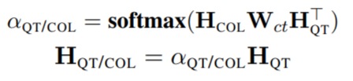
Implementation: Encoding (1/3)
Slot Predictions
Two Bi-LSTMs for
Quest: word-type
Column schema
Output
H-QT
H-COL
Three LSTMs for prediction
(5 LSMTs all together)
SELECT $AGGR $SEL_COL WHERE $COND_COL $OP $COND_VAL (AND $COND_COL $OP $COND_VAL)*
Implementation of
$AGG
$OP, $COND_VAL,
$SEL_COL, $COND_COL, $COND#

Slide 6
Implementation: Encoding (1/3)
Slot Predictions
Two Bi-LSTMs for
Quest: word-type
Column schema
Output
H-QT
H-COL
Three LSTMs for prediction
(5 LSMTs all together)
SELECT $AGGR $SEL_COL WHERE $COND_COL $OP $COND_VAL (AND $COND_COL $OP $COND_VAL)*
Implementation of
$AGG
$OP, $COND_VAL,
$SEL_COL, $COND_COL, $COND#

Slide 7
Implementation: Preprocessing (2/3)
Query:
Tokenization k-grams, k=[2-6] =>
type assignment.
Was J. Biden v. president of US in 2019 ?
(none)
(person)
(column)
(country)
(year)
Based on k-grams: Search
numbers, dates, years
Columns from schema
Entities in Freebase KB
If Table’s rows are available: use them!
Content sensitive model
Match tokes with both table schema and entries.

Slide 8
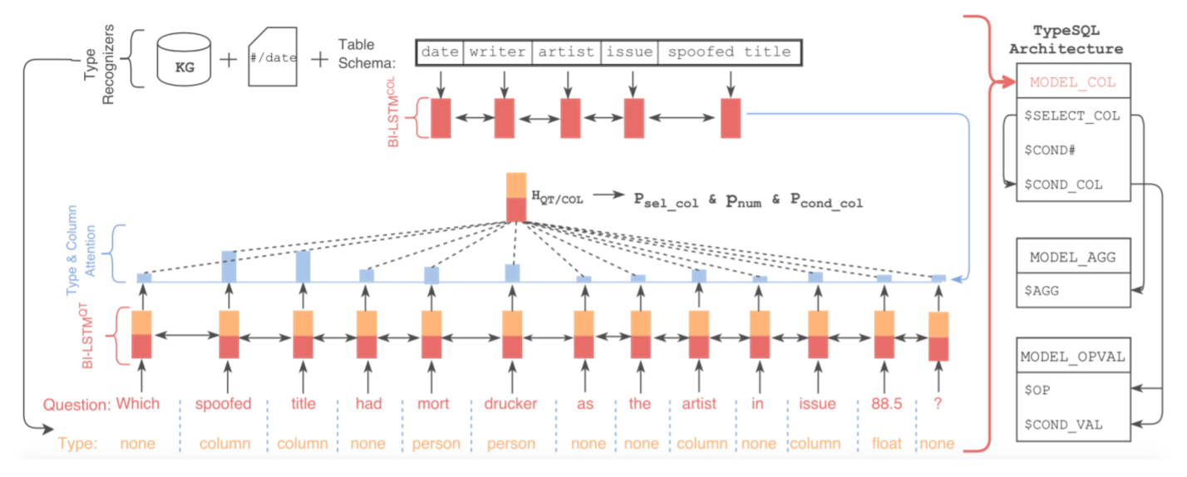
Paper’s paradigm

Slide 9
Paper’s paradigm

Slide 10


Implementation: Final Models(3/3)
MODEL_COL: (3 Slots)
$SELECT_COL
$COND#
$COND_Col
MODEL_COL- $SELECT_COL
MODEL_COL- $SELECT_COND#

Slide 11
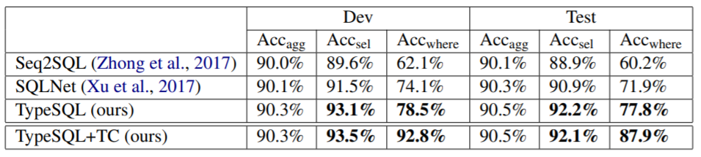
Evaluation & Plan
Three LSTMs for prediction
Recap & Action Plan
Accomplishing the ultimate goal: NLP text to SQL query

Slide 12
Evaluation & Plan
Three LSTMs for prediction
Recap & Action Plan
Accomplishing the ultimate goal: NLP text to SQL query

Slide 13
Evaluation & Plan
Three LSTMs for prediction
+2 LSMTs During preprocessing
Recap & Action Plan
$AGG
Accomplishing the ultimate goal: NLP text to SQL query
$OP, $COND_VAL,
$SEL_COL, $COND_COL, $COND#

Slide 14
Evaluation & Plan
Three LSTMs for prediction
+2 LSMTs During preprocessing
Recap & Action Plan
$AGG
Accomplishing the ultimate goal: NLP text to SQL query
$OP, $COND_VAL,
$SEL_COL, $COND_COL, $COND#
Two Basic Competitors: Seq2SQL & SQLNet

Slide 15
Evaluation & Plan
Recap & Action Plan
Implementation details
Accomplishing the ultimate goal: NLP text to SQL query
WikiSQL Dataset & Adam optimizer
Tuning: dimens, dropout rate, etc.
Embed: Glove & paragram_sl 999 czeng
My experiments on optimizers & tuning
Two Basic Competitors: Seq2SQL & SQLNet

Slide 16
Thanks for watching

